Slide 1

Effect of Yogurt Ice Cream on the Viability and Antidiabetic Potential of the Probiotics Lactobacillus acidophilus, Lacticaseibacillus rhamnosus, and Bifidobacterium animalis subsp. lactis after In Vitro Digestion。
RESEARCH DESIGN AND PAPER WRITING
周汇桥 1220012511
刘俊男 1220008732

Slide 2
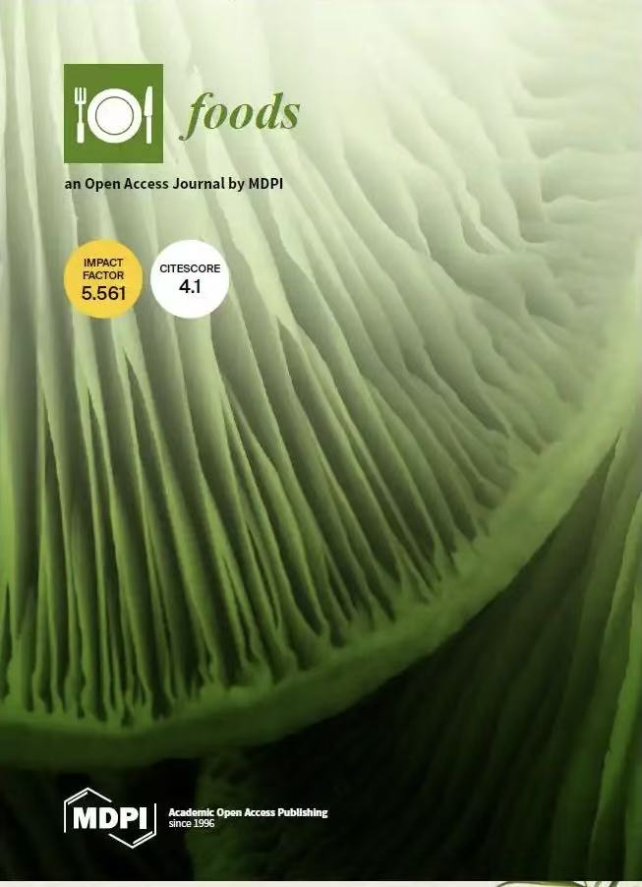
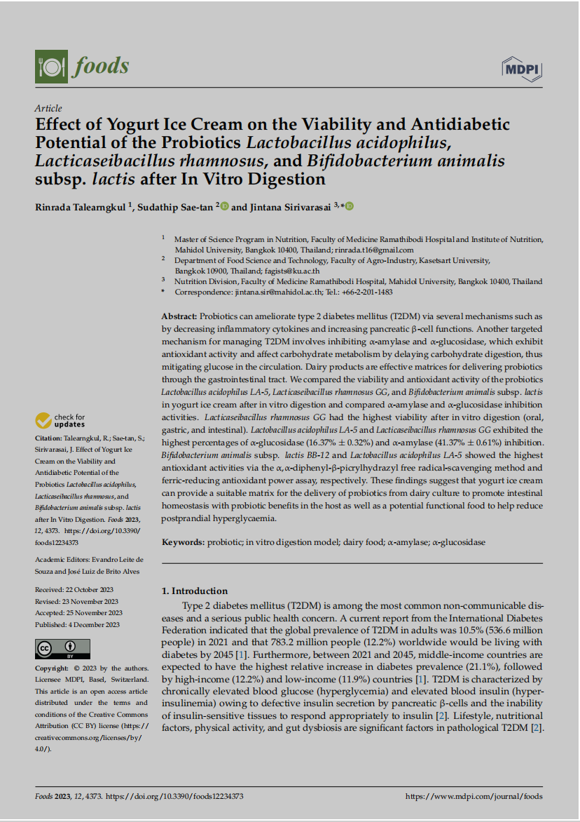
Research Overview
Effect of Yogurt Ice Cream on the Viability and Antidiabetic Potential of the Probiotics Lactobacillus acidophilus, Lacticaseibacillus rhamnosus, and Bifidobacterium animalis subsp. lactis after In Vitro Digestion。
Author：Rinrada Talearngkul,
Sudathip Sae-tan, Jintana Sirivarasai
journal: Foods (Impact Factor: 5.561, Q1 Journal)
Publication Time: 4 December 2023

Slide 3
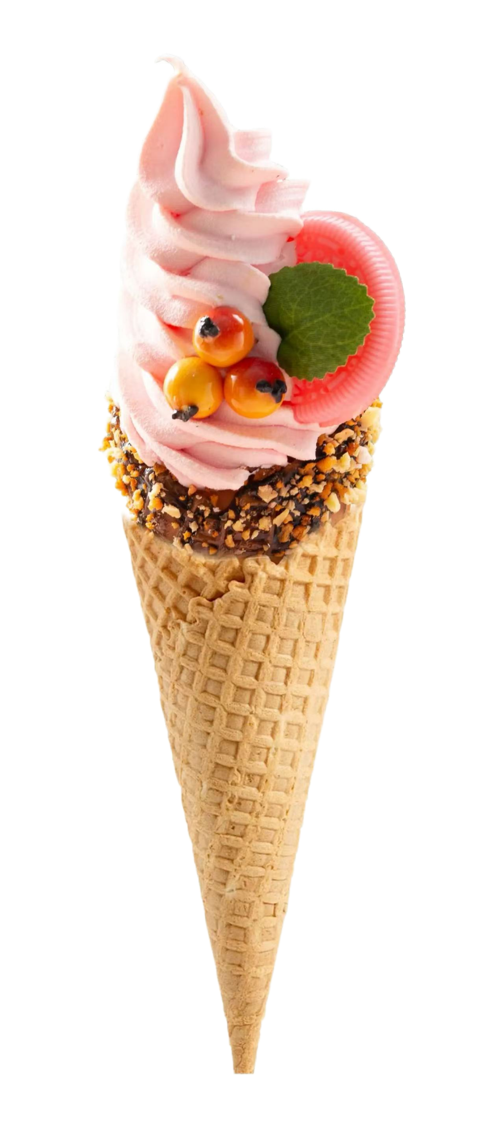
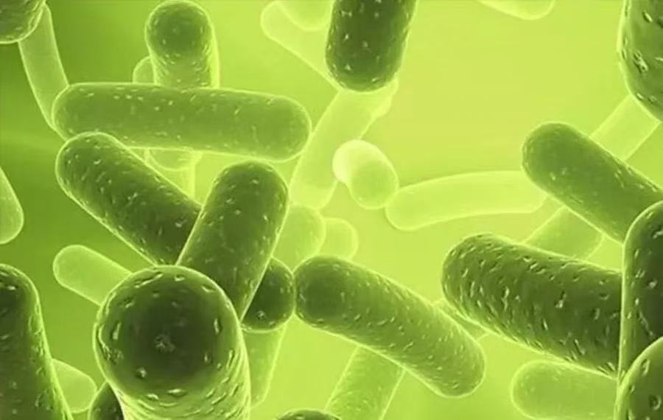
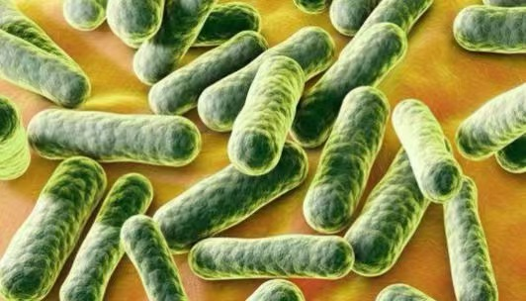
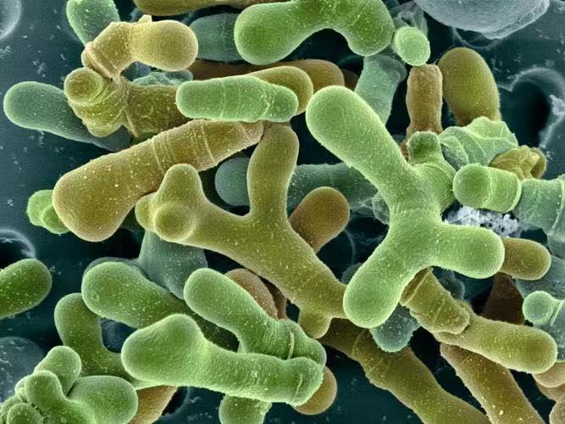
Research Overview
Lactobacillus acidophilus LA-5 (LA-5)
Lacticaseibacillus rhamnosus GG (LGG)
Bifidobacterium animalis subsp. lactis BB-12 (BB-12)
1.Provide protective matrix.
2.The environment that promotes the growth of probiotics.
3.The potential as a functional food.

Slide 4
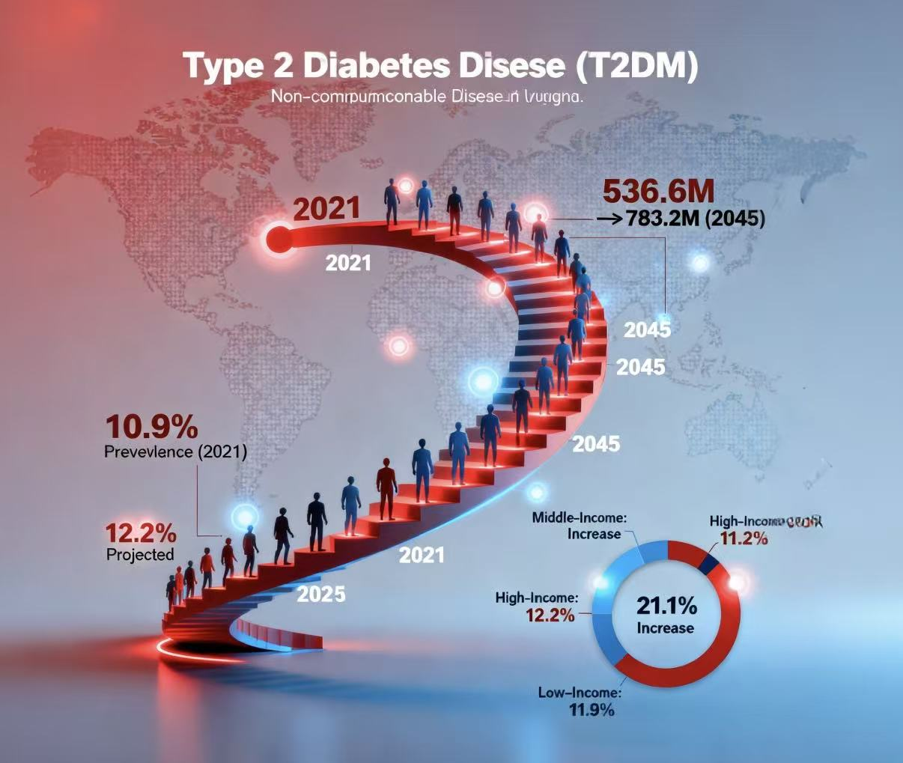
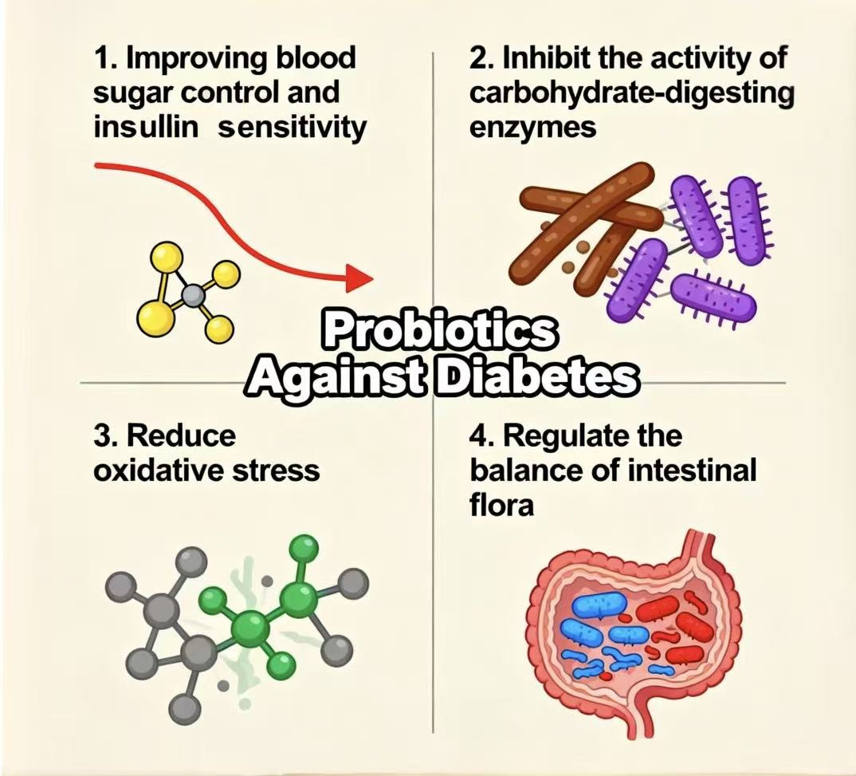
Research Background
The anti-diabetic mechanism of probiotics
Research Hypotheses：
Yogurt ice cream can serve as an effective delivery vehicle for probiotics, maintaining their survival rate in the gastrointestinal tract.
Different probiotic strains exhibit different anti-diabetic capabilities in yogurt ice cream.

Slide 5
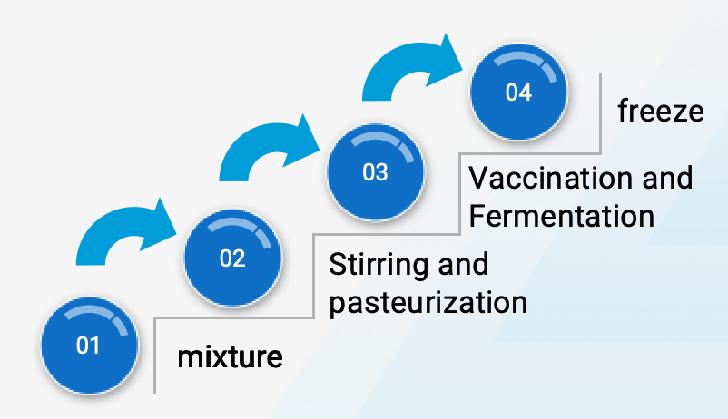
research method
raw material ratio
preparation technology
the liquid mixture | milk | 132g
 | whip cream | 125g
soild misture | suger | 100g
 | skim milk powder | 42g
 | maltodextrin | 35g
 | Stabilizer and emulsifier | 4.5g
 | salt | 0.2g
 | citric acid | 4g
 | yogurt | 580g
probiotic culture | LA-5 | 1 × 10¹¹ CFU/g
 | BB-12 | 1 × 10¹¹ CFU/g
 | LGG | 5 × 10¹¹ CFU/g

Slide 6
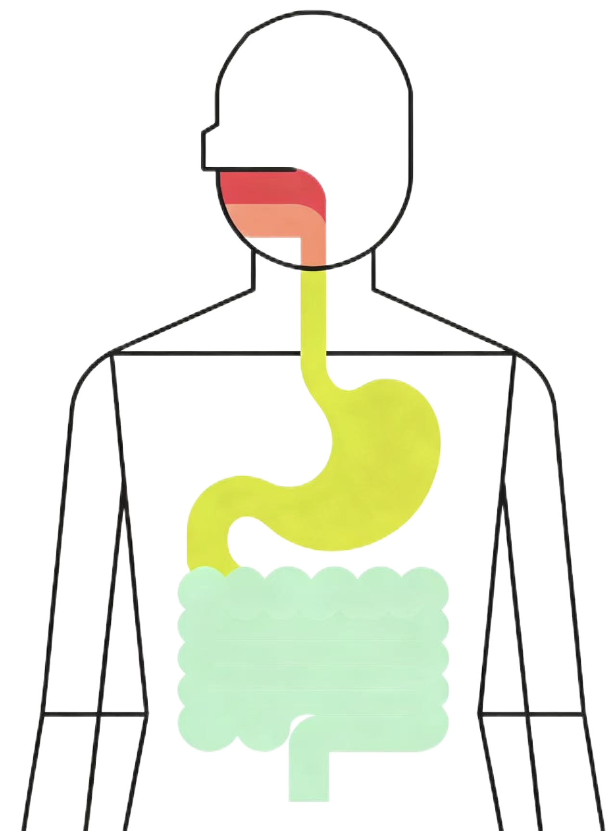
research method
Key detection method
Static in vitro digestion model（INFOGEST）
Probiotic activity
Bacterial colony counting technique
pH: 7.0
1.5mL α-amylase solution
α-Amylase inhibition test（DNSA）
Enzyme inhibitory activity
pH: 3.0
4.55 mL pepsin solution
α-Glucosidase inhibition test（pNPG）
pH: 7.0
8 mL pancreatic enzyme solution and 1.25 mL bile extract
DPPH radical scavenging method
antioxidant activity
FRAP iron reduction capacity method

Slide 7
Experimental results
刘俊男 1220008732

Slide 8
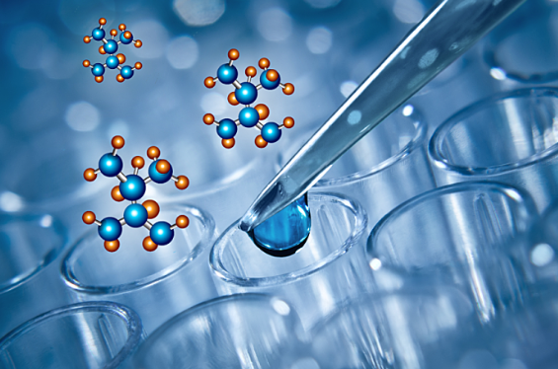
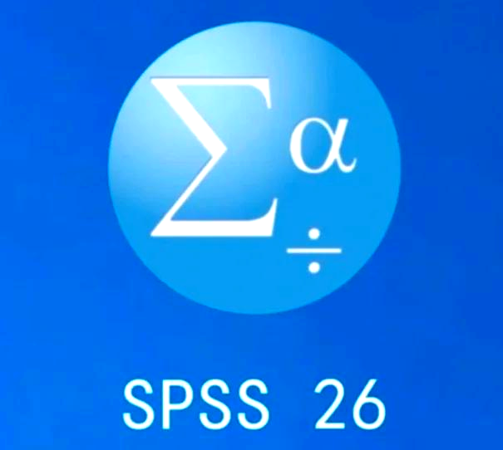
Key detection methods
Colony counting
Detection of alpha-amylase（α淀粉酶） and alpha-glucosidase（α葡糖苷酶） inhibitory activity
Antioxidant activity test

Slide 9
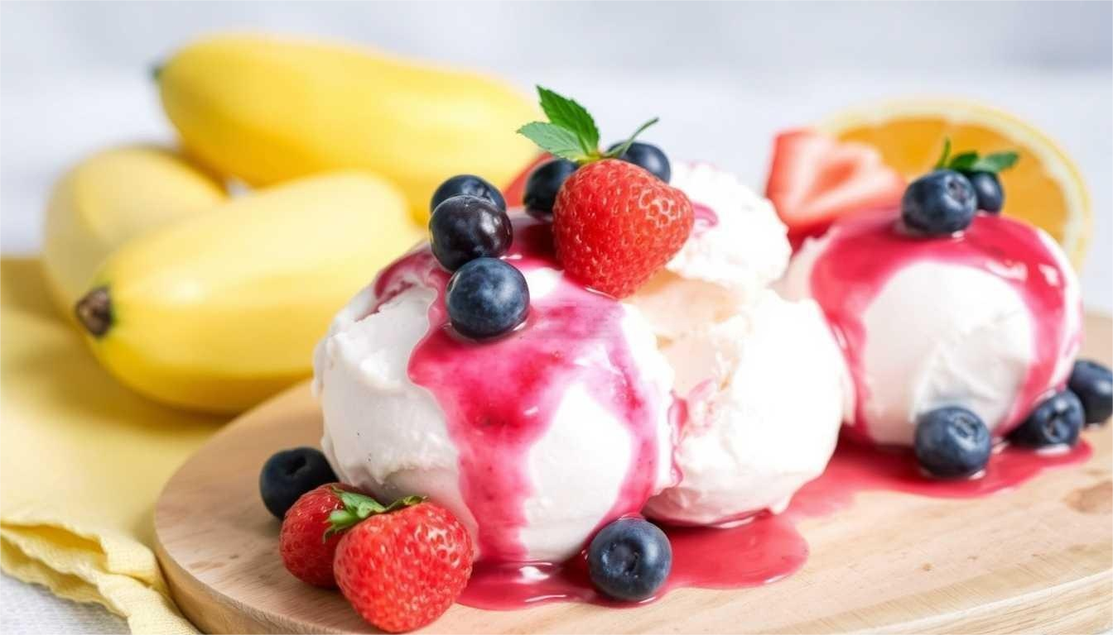
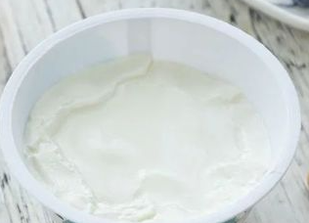
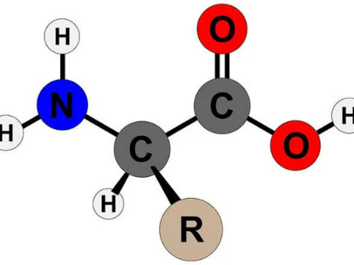
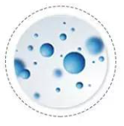

Experimental results
Relevant meaning:
Nutrients of yogurt ice cream
probiotics
against
Calories: 140KJ Carbohydrate: 19g
Protein: 4g Sodium: 60mg
Fat: 5g …
Bioactive peptides

Slide 10
1.Activity change of probiotics after in vitro digestion
Yogurt Ice cream Group | Before digestion （unit：log CFU/g） | Mouth phase | Gastric phase | Small intestinal phase
YI-Control | ND（未检出） | ND | ND | ND
YI-LA-5 (嗜酸乳杆菌） | 6.61±0.02 | 5.12±0.02 | 4.65±0.09 | 4.11±0.04
YI-BB-12 (双歧杆菌） | 6.23±0.03 | 4.53±0.57 | 3.11±0.12 | ND
YI-LGG （鼠李糖乳杆菌） | 7.68±0.04 | 6.35±0.09 | 6.23±0.08 | 6.04±0.03
Tolerance rank：LGG ＞ LA-5 ＞ BB-12
Possible reason：lactobacilli (乳酸杆菌） handle freezing and stomach acid better than bifidobacteria (双歧甘菌）.
LA-5 — insufficient activity to achieve probiotic effect
LGG — enough to colonize in gut

Slide 11
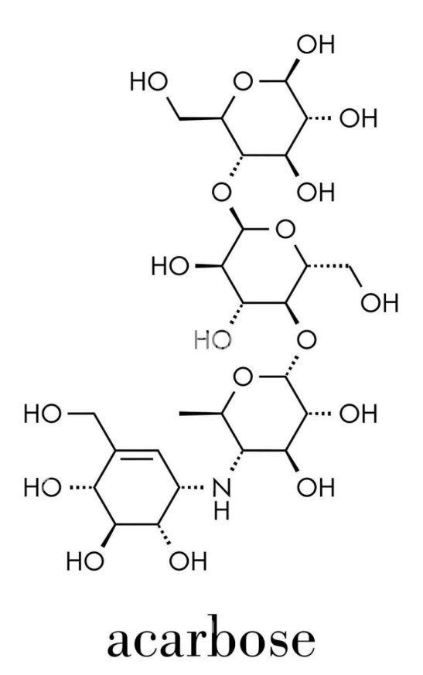
2.Enzyme inhibition results
IC50 (inhibitory concentration):
against α-amylase and α-glucosidase is 0.026 mg/mL and 7.21 mg/ml, respectively
Yogurt IC | α-Amylase Inhibition(%) | α-Glucosidase Inhibition (%)
YI-LA-5 | 19.31 ± 0.30 | 16.37 ± 0.32
YI-BB-12 | 16.14 ± 0.70 | 11.54 ± 0.21
YI-LGG | 41.37 ± 0.61 | 14.41 ± 0.26
Positive control (Expectation)

Slide 12
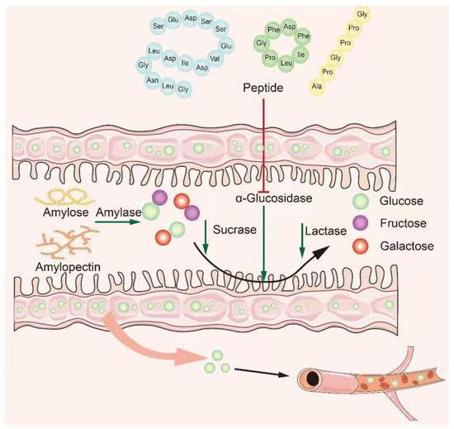
2.Enzyme inhibition results
It shows probiotics turn milk protein into peptides that stick to enzyme active sites, stopping them from breaking down carbohydrates. Therefore, it can reduce after-meal blood sugar.

Slide 13
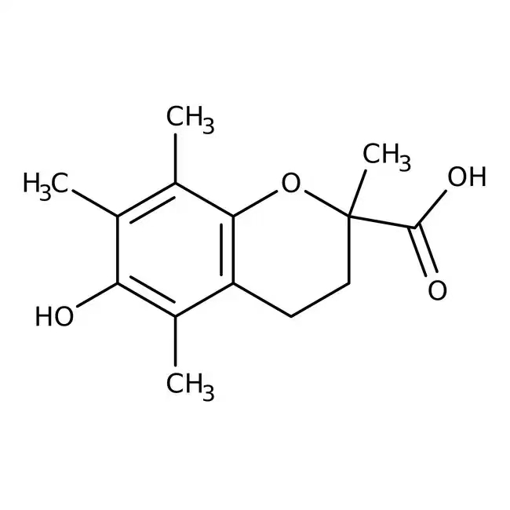
3. Antioxidant activity results
Yogurt IC | DPPH (mg Trolox /g)
YI-CT | 21.40 ± 0.40
YI-LA-5 | 21.40 ± 0.37
YI-BB-12 | 23.95 ± 0.28
YI-LGG | 23.50 ± 0.33
Trolox（water-soluble vitamin E analog）：positive control ＆ common standard for antioxidant activity tests
Meaning: Both BB-12 AND LGG strains can get rid of free radicals by providing hydrogen atoms(氢原子），and this helps reduce oxidative stress damage.

Slide 14
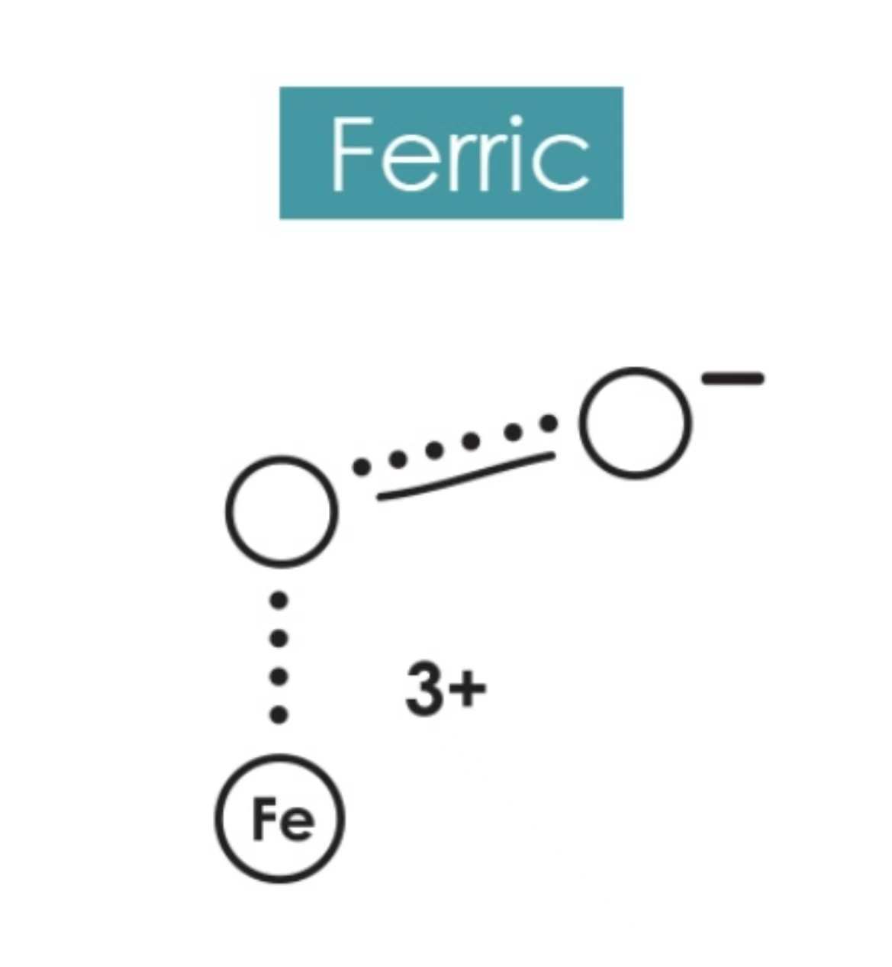
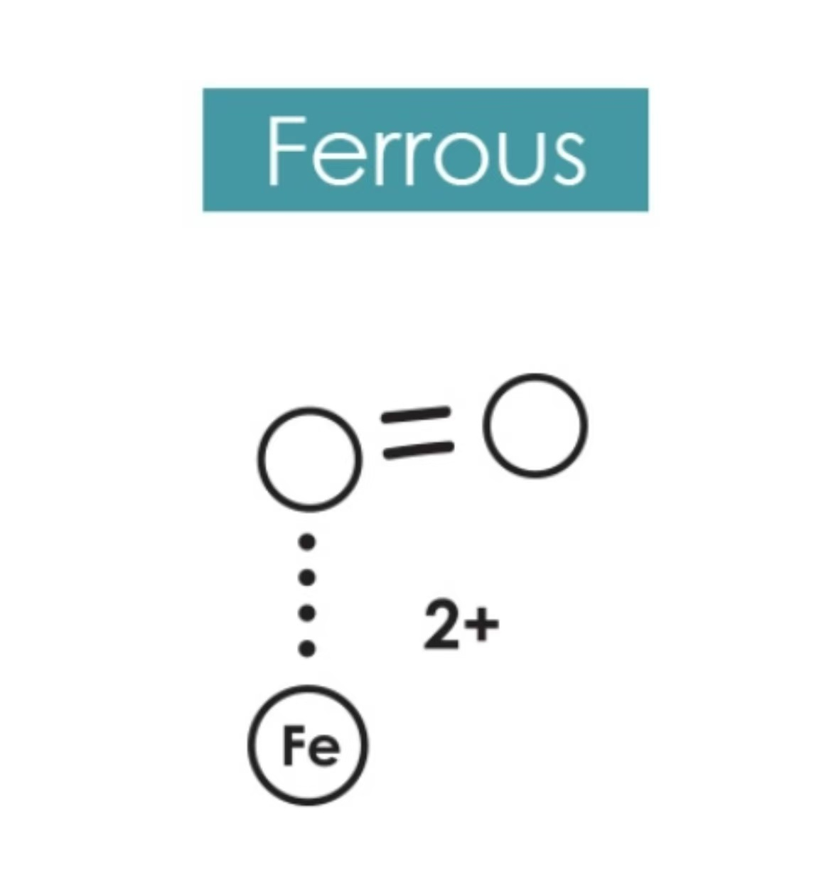
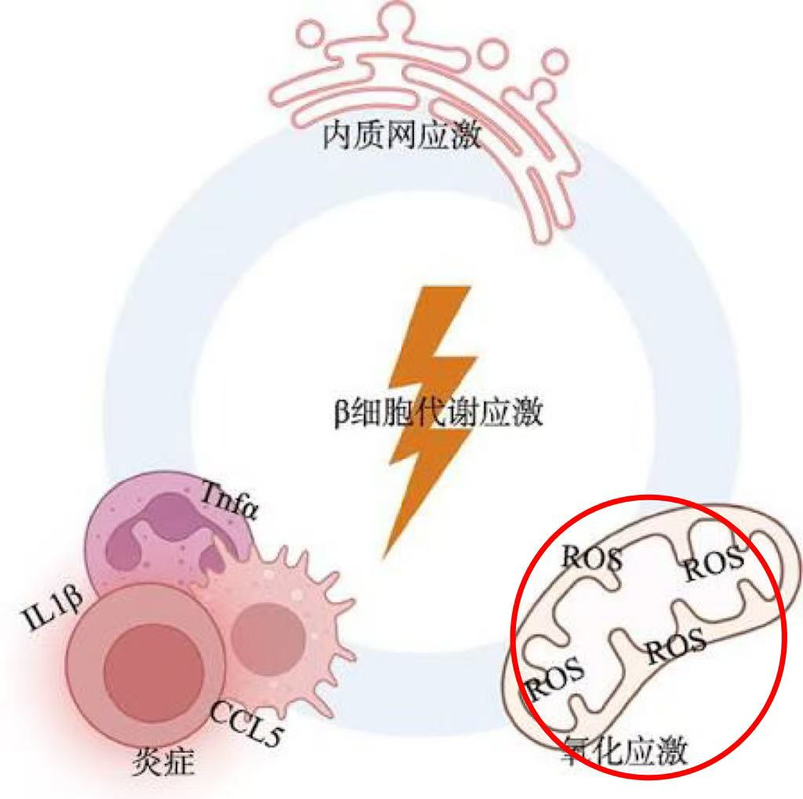
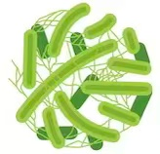
3. Antioxidant activity results
Yogurt IC
YI-CT
YI-LA-5
YI-BB-12
YI-LGG
FRAP (mg Trolox /g)
51.47 ± 0.23
97.63 ± 0.25
67.31 ± 0.17
54.55 ± 0.40
Donating electrons
Lactobacillus acidophilus

Slide 15
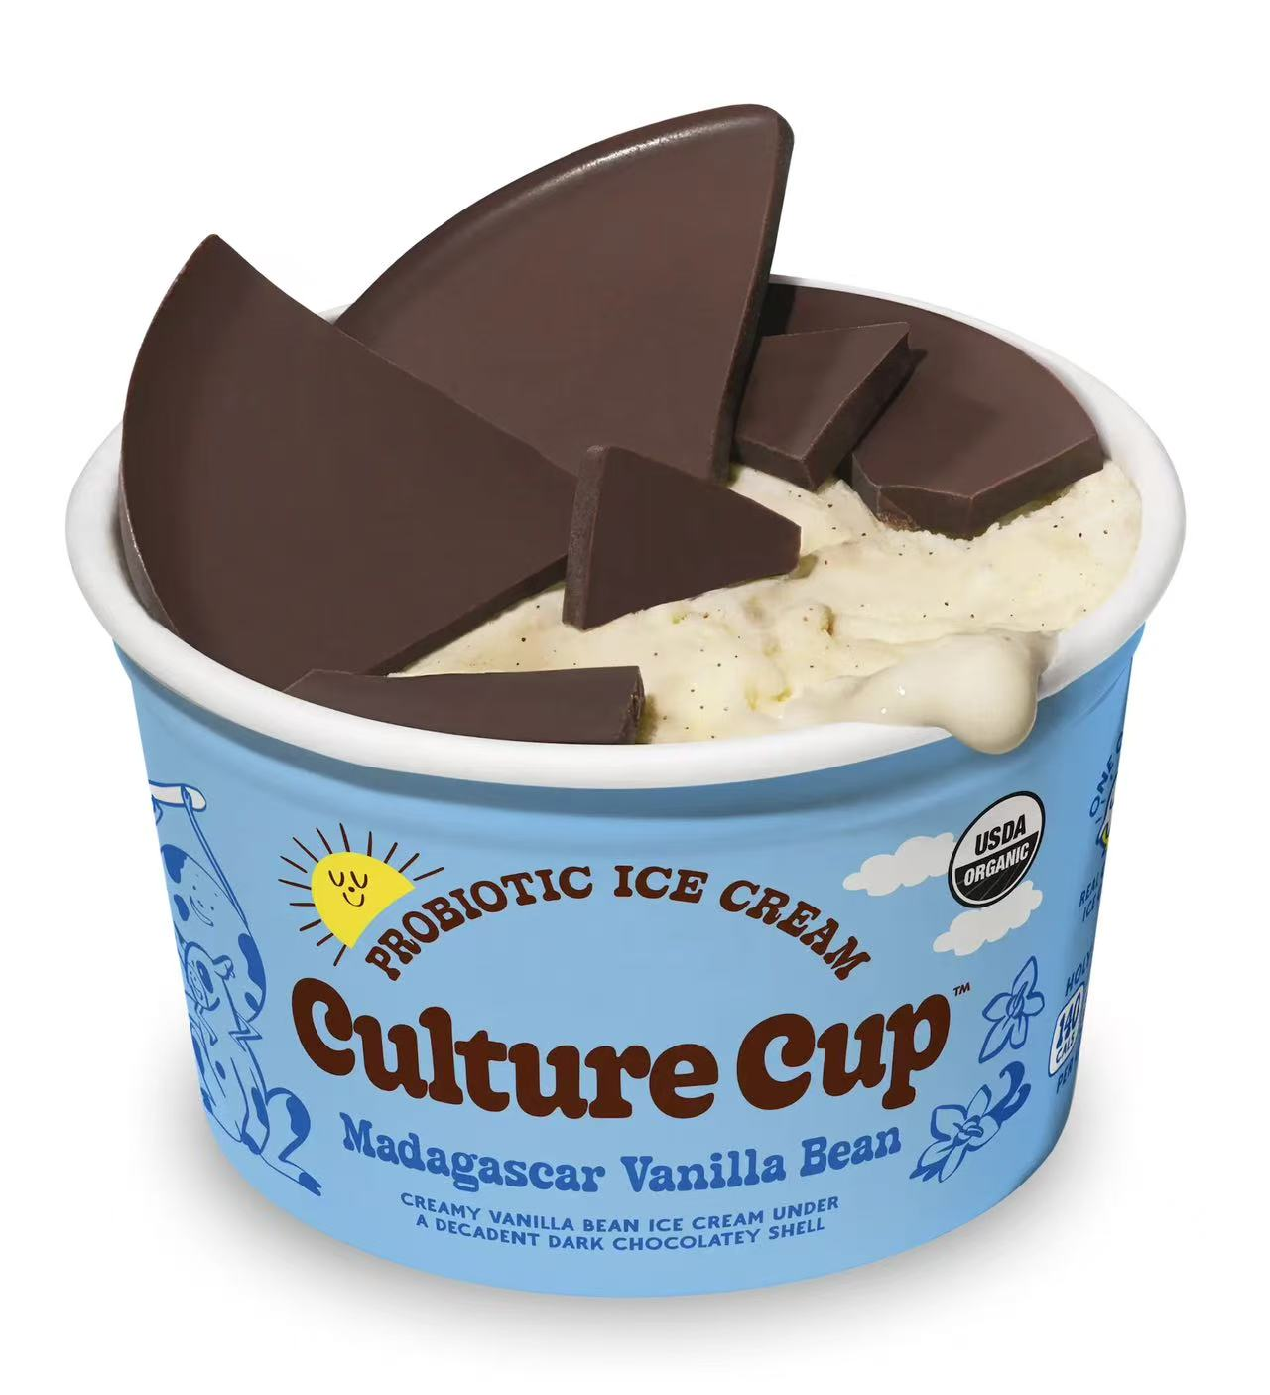
Core conclusions
The study confirms that yogurt ice cream is a great probiotic carrier—especially for the LGG strain(鼠李糖乳杆菌), which stays alive through the entire digestion process.
Each probiotic strain has unique antidiabetic “strengths”: LA-5 does well in α-glucosidase inhibition and FRAP iron reduction activity, and LGG is ahead when it comes to α-amylase inhibition and DPPH free radical scavenging
The research suggests that this probiotic yogurt ice cream could be a new functional food to help T2DM patients control after-meal blood sugar

Slide 16
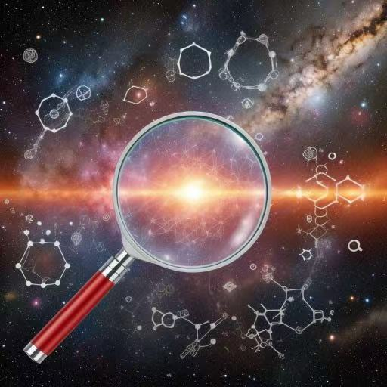
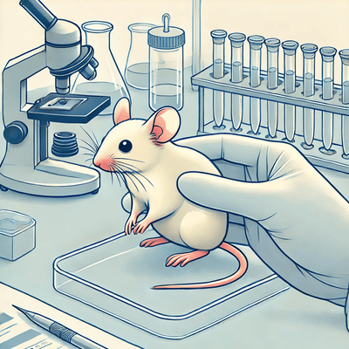
Limiitations
The study fails to determine the specific substances （bioactive peptides） produced by probiotics after decomposing milk proteins.
The lack of in vivo experiments, with no animal experiments conducted

Slide 17
澳门科技大学
Thanks for listening！
THANK YOU
Reporters：周汇桥 ＆ 刘俊男
2025.11.6

